Slide 1
geoMapr: A Shiny Application for Enriched Analysis of Drug Utilization Data
Jaejoon Song
U.S. Food and Drug Administration, Center for Drug Evaluation and Research

Slide 2
Acknowledgements
This research was supported by the FDA Center for Drug Evaluation and Research (CDER) Safety Research Interest Group (SRIG) program and by an appointment to the Research Participation Program at CDER administered by Oak Ridge Institute for Science and Education (ORISE) through an interagency agreement between Department of Energy and FDA.

Slide 3
Disclaimer
This presentation reflects the views of the authors and should not be construed to represent FDA’s views or policies.

Slide 4
Outline
Prescription drug dispensing database
Software for analysis of drug dispensing database
Example analysis with naloxone dispensing

Slide 5
Background
The FDA is expanding its capacity for proactive surveillance of drug abuse, in addition to other drug safety signals.
In post-market safety surveillance, pharmacy dispensing data provide valuable insights to the Agency for oversight of drug utilization.
The drug dispensing data include the number of product dispensings aggregated over a time frame (e.g., months).

Slide 6
Motivation
The drug dispensing data include geographical reference for the number of product dispensings (e.g., states, core-based statistical areas).
One promising approach to enhance surveillance using these data would be through data enrichment: geographically referenced public data sources covering detailed information on demographic, socioeconomic, and healthcare service can be overlaid to proprietary, nationally projected data for prescription drug dispensing.

Slide 7
Goal
To develop a data analysis pipeline and software to perform enriched analysis of prescription drug dispensing data.
Software will be deployed as an FDA internal webpage.
Software will perform a five-step analysis pipeline, that consists of data enrichment, machine learning, causal inference, and spatio-temporal modeling.

Slide 8
Database
The Symphony Health, PHAST™ Prescription Monthly database was used to obtain the estimated number of naloxone prescriptions dispensed from U.S. retail, mail-order/specialty pharmacies from January 2014 through December 2018, annually.

Slide 9
Database
Symphony Health PHAST™ Prescription Monthly (PHAST PM)
PHAST PM is a syndicated view of U.S. retail, mail order and long-term care pharmacy prescription activity, updated on a monthly basis.
PHAST Prescription Monthly covers over 65,000 pharmacies in the sample including retail, mail order, specialty and other non-retail outlets.
The dispensed prescriptions in the sample represent approximately 92% of all U.S. retail prescriptions (cash, Medicaid, commercial) as well as 69% of all U.S. mail order prescriptions. The retail and mail order prescriptions are projected to the national level.

Slide 10
Five-step Pipeline
Step 1: Descriptive statistics & data visualization
Step 2: Data enrichment
Step 3: Exploratory analysis
Step 4: Statistical modeling
Step 5: Analysis report generation

Slide 11
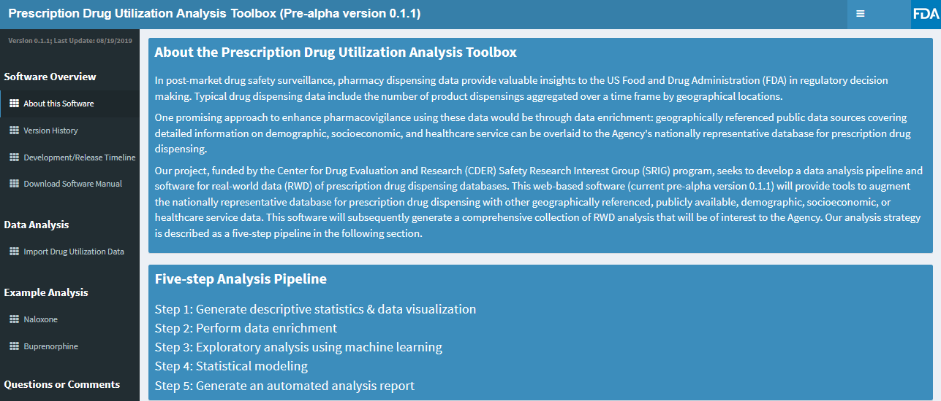
Web-based Software

Slide 12
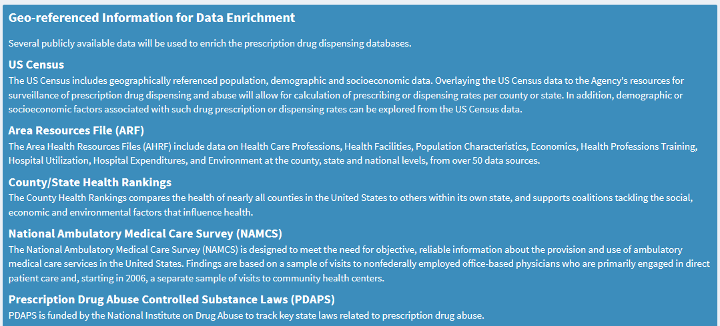
Geographic Data Enrichment

Slide 13
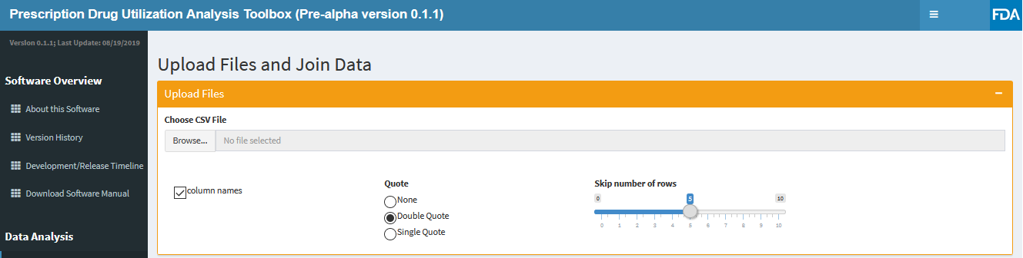
Data Import

Slide 14
Sample Analysis
We demonstrate the use of this web-application in analyzing naloxone dispensed from U.S. retail, mail-order/specialty pharmacies from January 2014 through December 2018, using data obtained from the PHAST™ PM database.
Naloxone is an opioid antagonist used to counter the effects of opioid overdose.

Slide 15
Sample Analysis
In attempts to mitigate the opioid overdose crisis, all fifty states and the District of Columbia have now modified their laws to increase access to naloxone, the standard first-line treatment for opioid overdose (Guy et al., 2019).
It has been reported that states with legal mandate to co-prescribe naloxone with opioids have higher dispensing rates (Sohn et al., 2019).

Slide 16
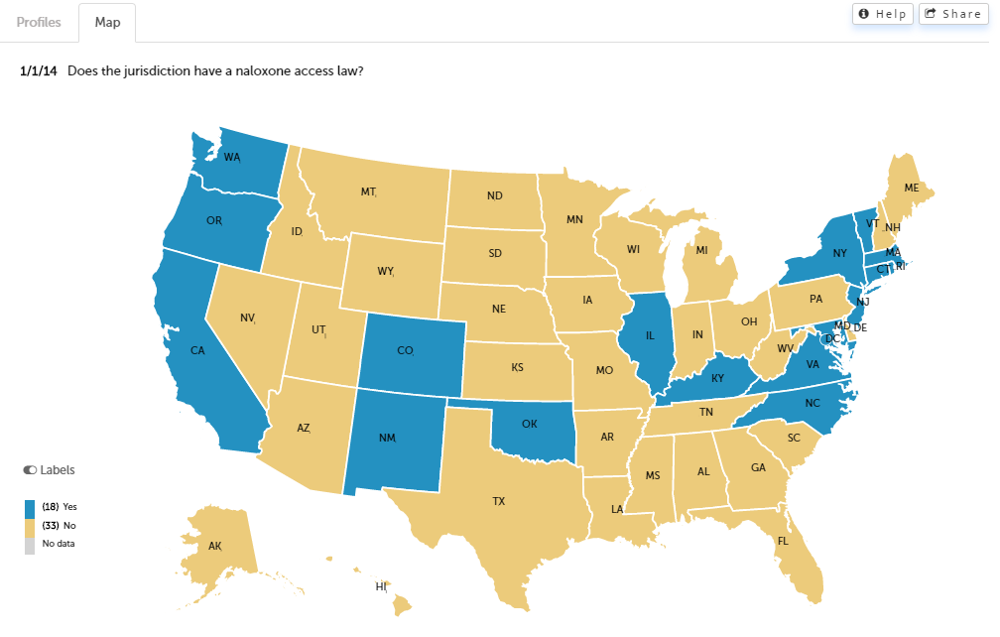
States with Naloxone Access Law
Source: http://pdaps.org

Slide 17
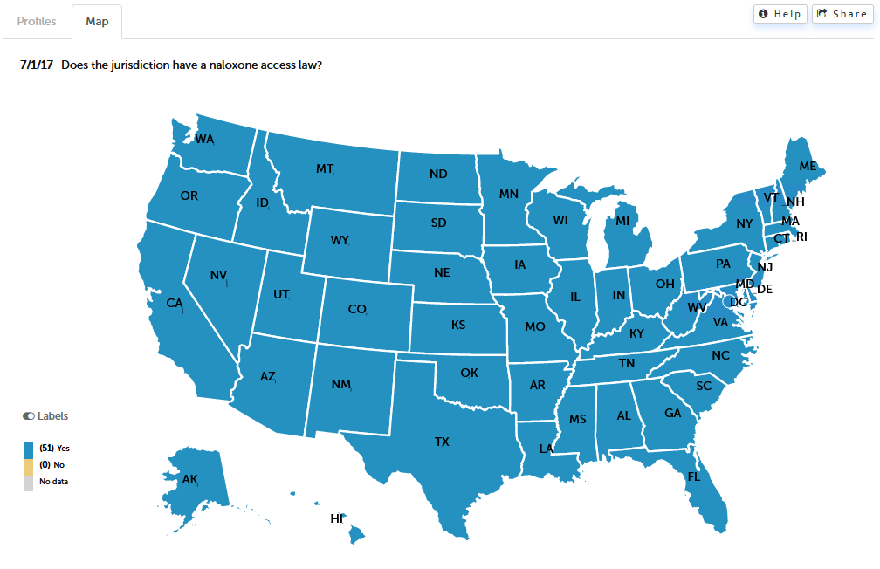
States with Naloxone Access Law
Source: http://pdaps.org

Slide 18
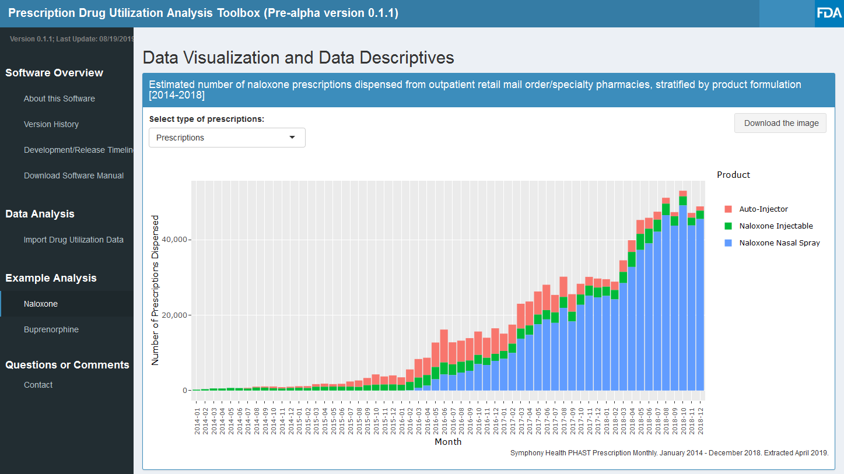
Estimated Number of Naloxone Prescriptions Dispensed 2014-2018

Slide 19
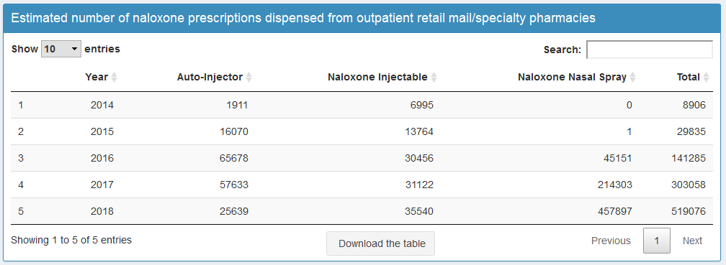
Estimated Number of Naloxone Prescriptions Dispensed 2014-2018

Slide 20
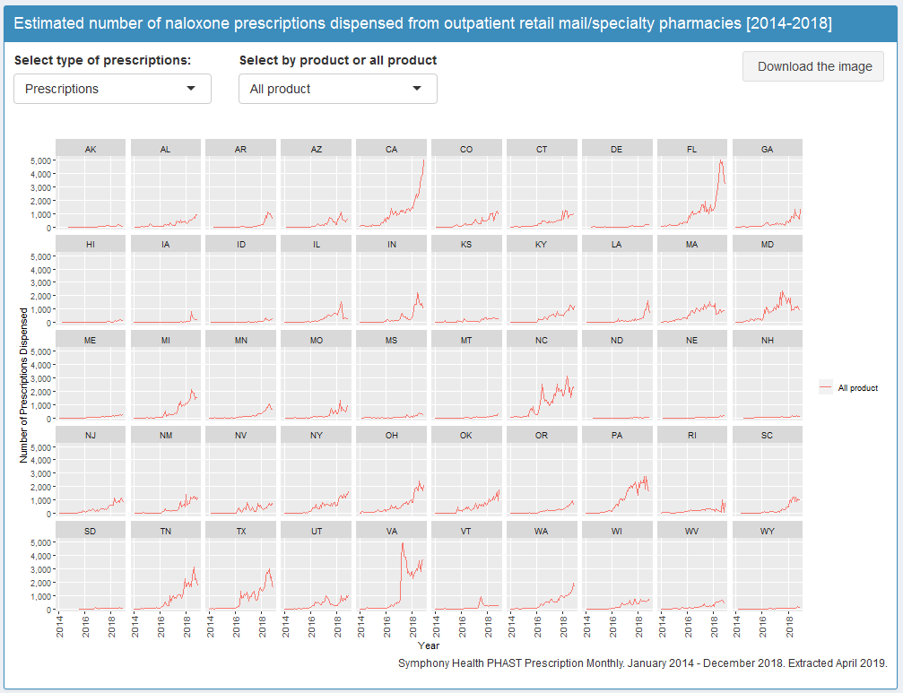
Estimated Number of Naloxone Prescriptions Dispensed 2014-2018

Slide 21
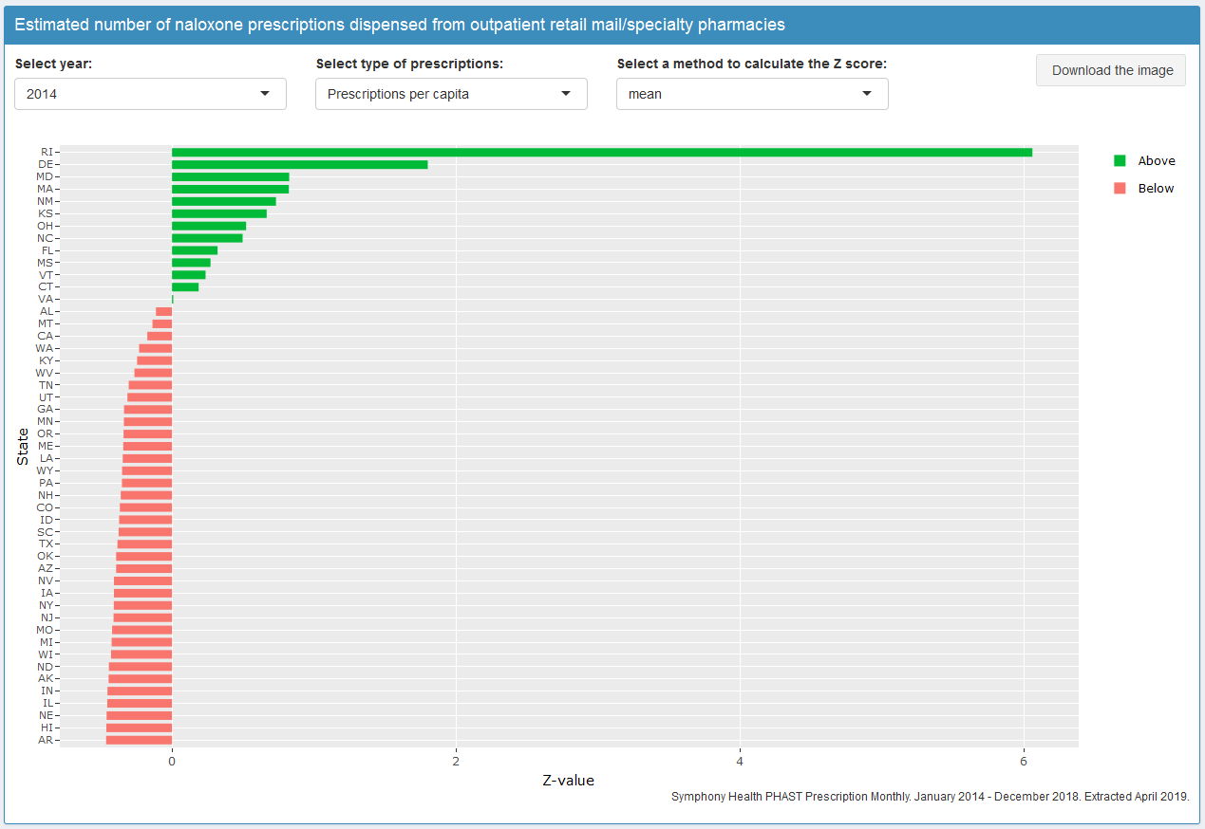
Standardized Scores (2014)

Slide 22
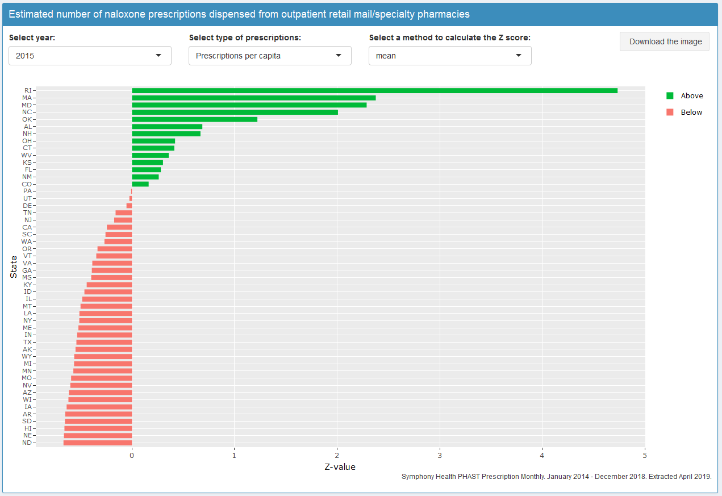
Standardized Scores (2015)

Slide 23
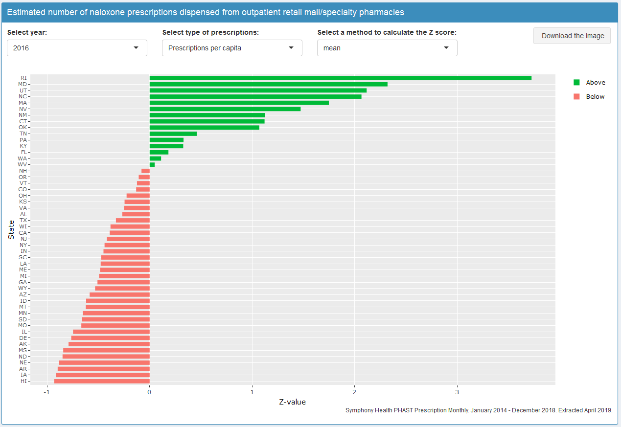
Standardized Scores (2016)

Slide 24
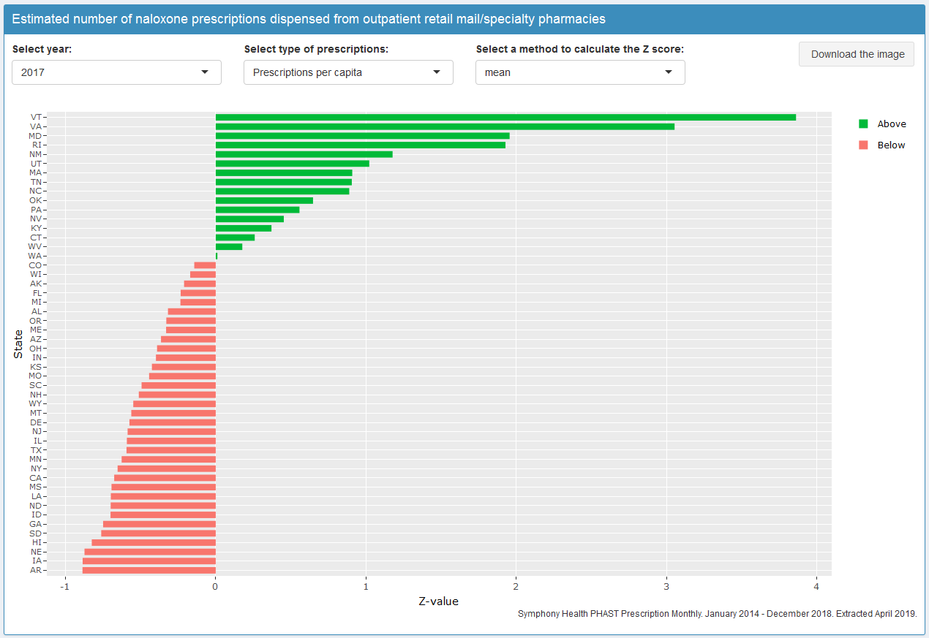
Standardized Scores (2017)

Slide 25
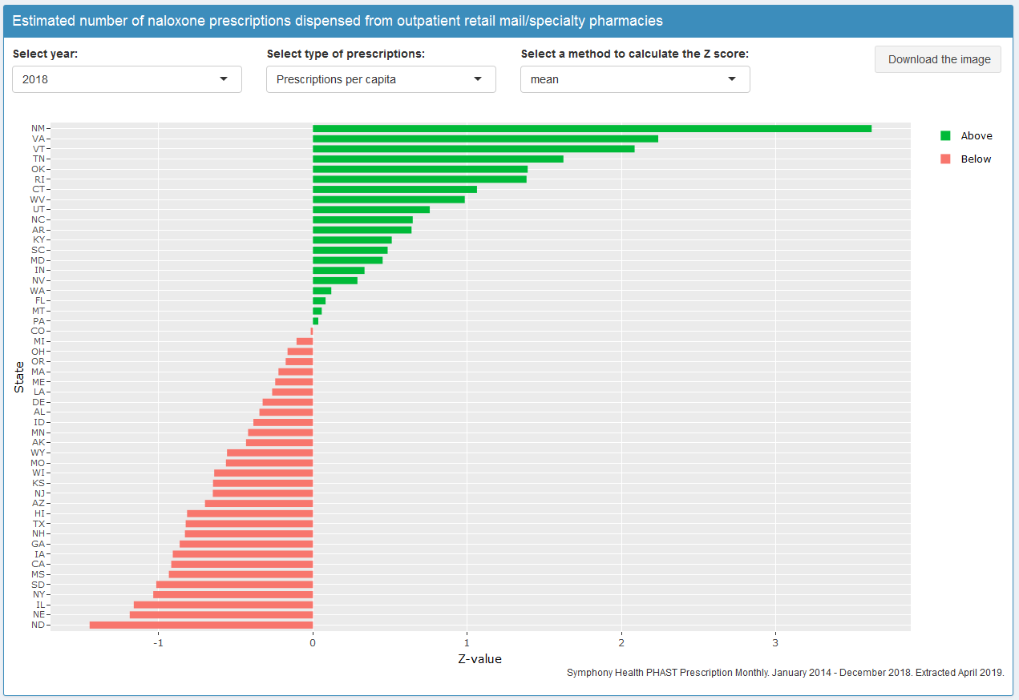
Standardized Scores (2018)

Slide 26
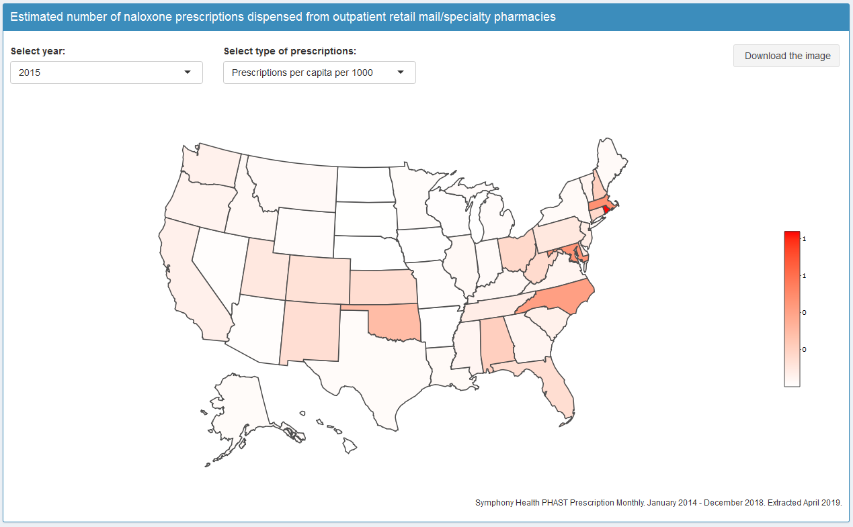
Per-capita Dispensing (2015)

Slide 27
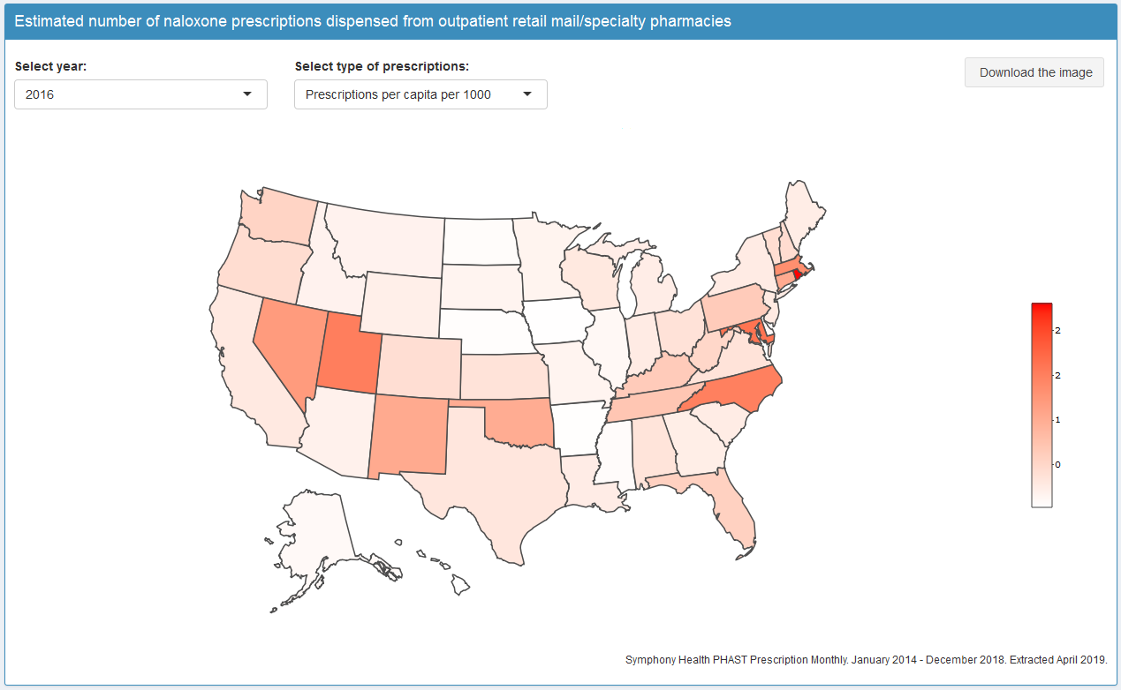
Per-capita Dispensing (2016)

Slide 28
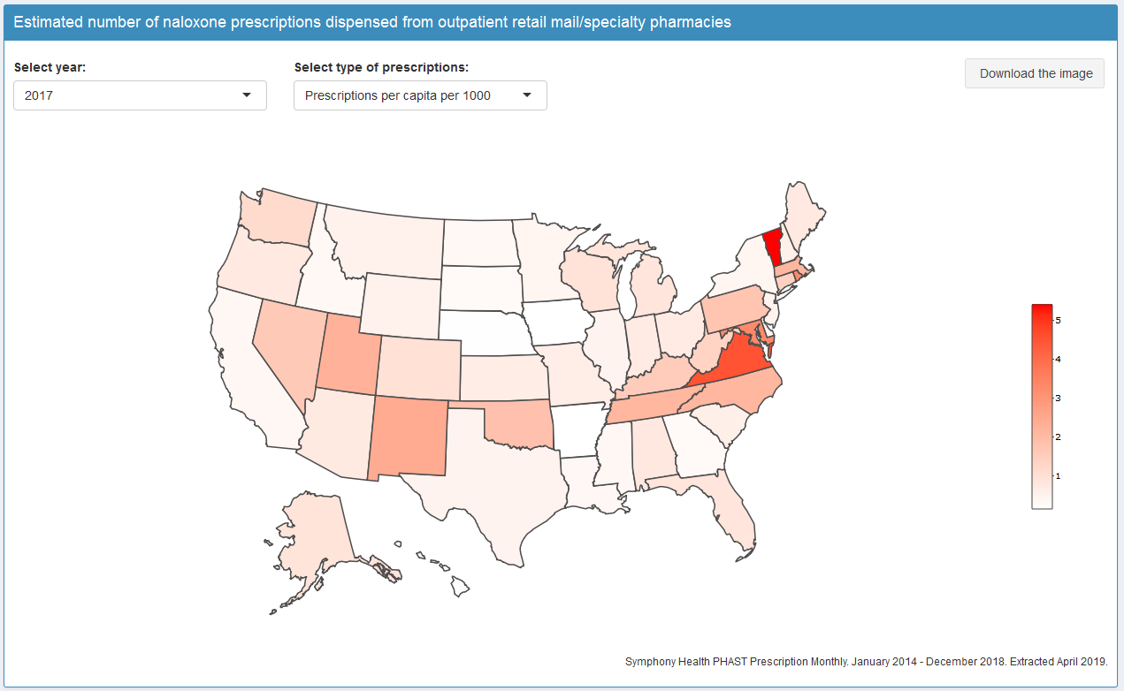
Per-capita Dispensing (2017)

Slide 29
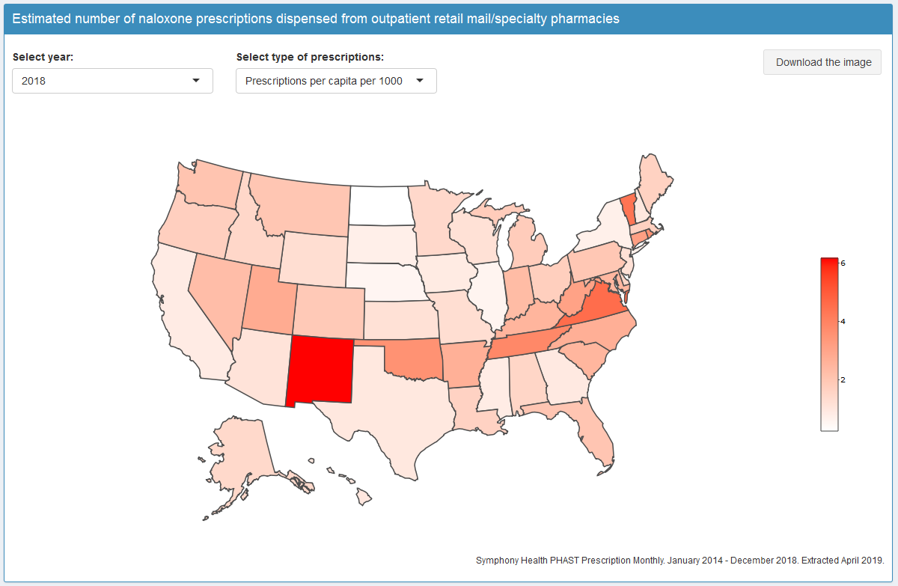
Per-capita Dispensing (2018)

Slide 30
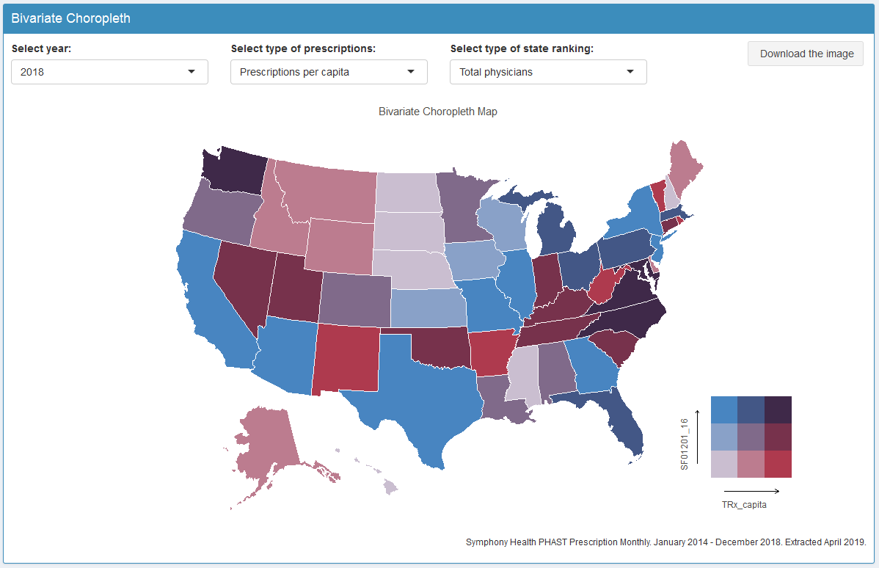
Bivariate Choropleth (2018)

Slide 31
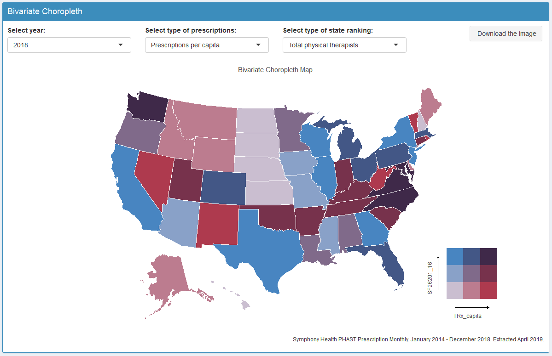
Bivariate Choropleth (2018)

Slide 32
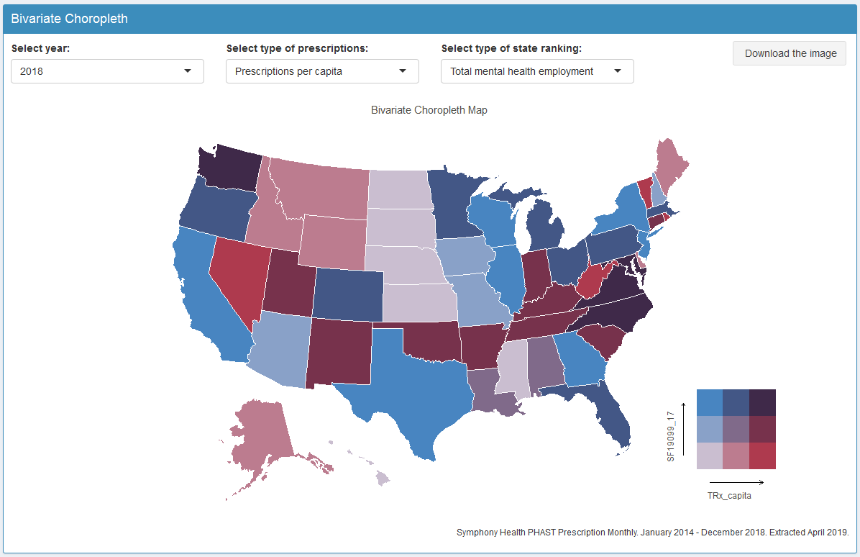
Bivariate Choropleth (2018)

Slide 33
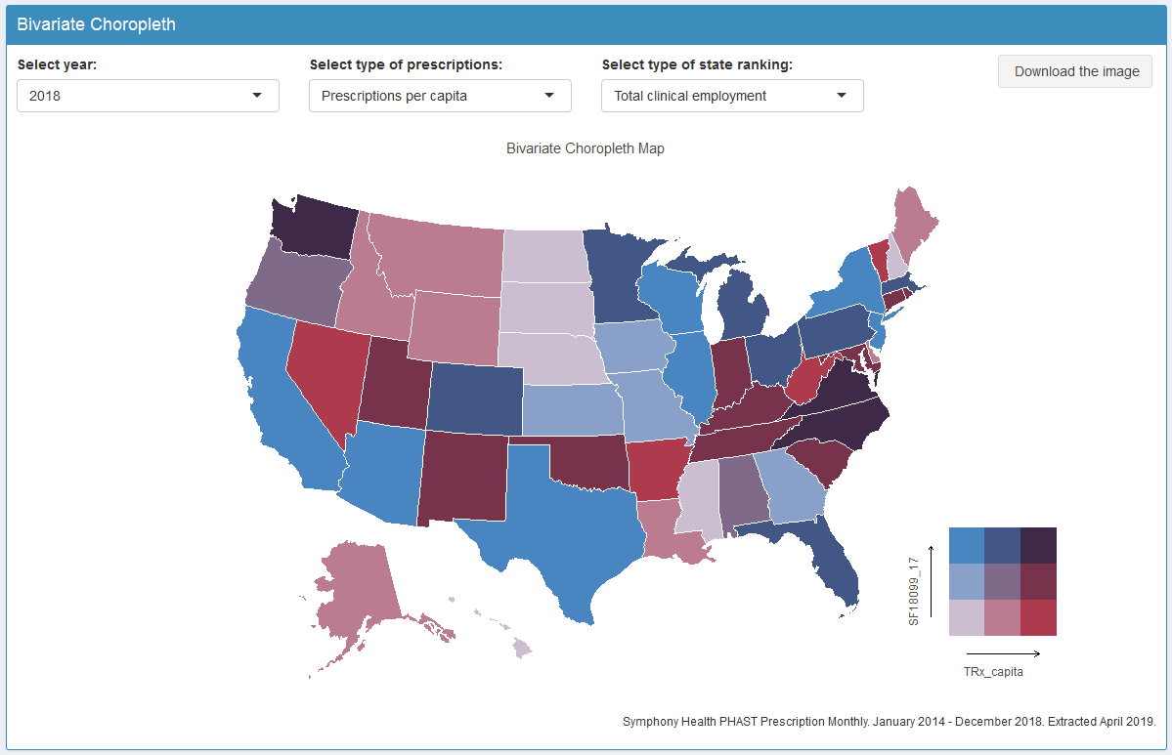
Bivariate Choropleth (2018)

Slide 34
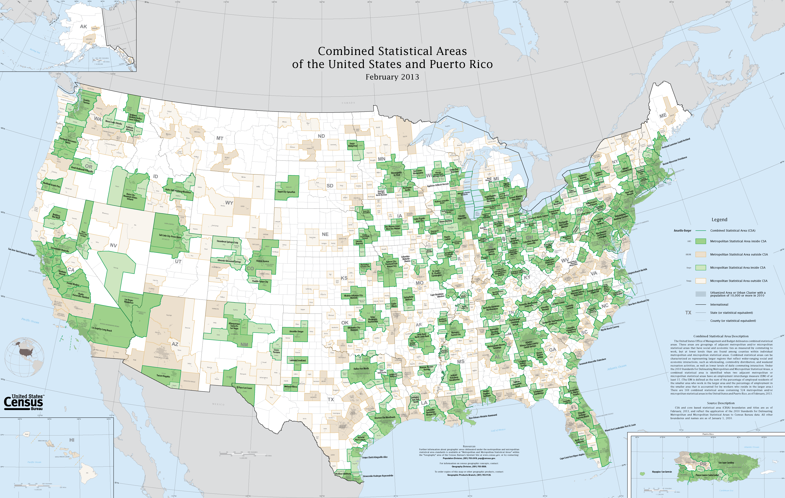
Identifying Geographical Hotspots
The prescription drug dispensing data are available at core-based statistical areas (CBSA).
There are 929 CBSAs in the United States (~94% of pop.)
Source: US Census

Slide 35
Identifying Geographical Hotspots
Hotspot identification can be useful to point areas with potential prescription drug abuse or limited access.
Visual examination of small geographical areas can be a challenge.
We introduce a two-step procedure to:
Identify geographic areas that had significant change over time in prescription drug dispensing, and
Characterize clusters of geographic areas that share similar temporal change patterns.

Slide 36
Identifying Geographical Hotspots

Slide 37
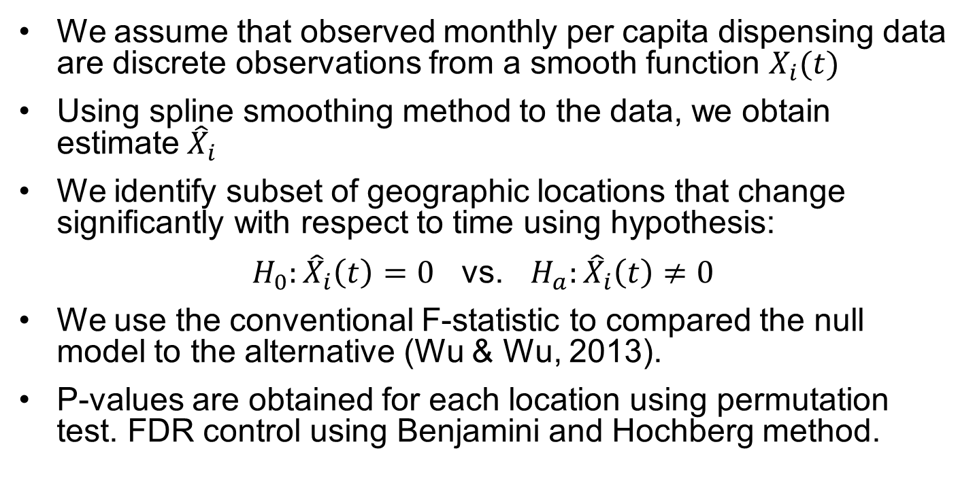
Step 1: Identifying Areas with Change
We assume that observed monthly per capita dispensing data are discrete observations from a smooth function $X_{i}(t)$
Using spline smoothing method to the data, we obtain estimate${ \hat{X}}_{i}$
We identify subset of geographic locations that change significantly with respect to time using hypothesis:
$H_{0}:{\hat{X}}_{i}\left(t\right)=0$ vs. $H_{a}:{\hat{X}}_{i}\left(t\right)≠0$
We use the conventional F-statistic to compared the null model to the alternative (Wu & Wu, 2013).
P-values are obtained for each location using permutation test. FDR control using Benjamini and Hochberg method.

Slide 38
Step 2: Characterize Temporal Change
Obtain clusters of geographic areas that share similar temporal change patterns using Iterative Hierarchical Clustering (IHC) algorithm (Carey et al., 2016)
IHC implements three steps:
Initialization
Determine initial cluster membership by Spearman correlation dist.
Merging
Re-assess and merge clusters by cluster centers
Pruning
Re-examine each member with cluster center

Slide 39
Identifying Geographical Hotspots
We applied the two-step procedure to naloxone prescription dispensing data 2014-2018 (available monthly).
Data included 762 CBSAs with at least one unit of naloxone dispensing.
We identified 590 CBSAs with significant changes in naloxone dispensing between 2014-2018.
We grouped the CBSAs with significant change over time into clusters that share similar patterns of change.
36 Clusters were identified: 4 clusters with at least 30 CBSAs.

Slide 40
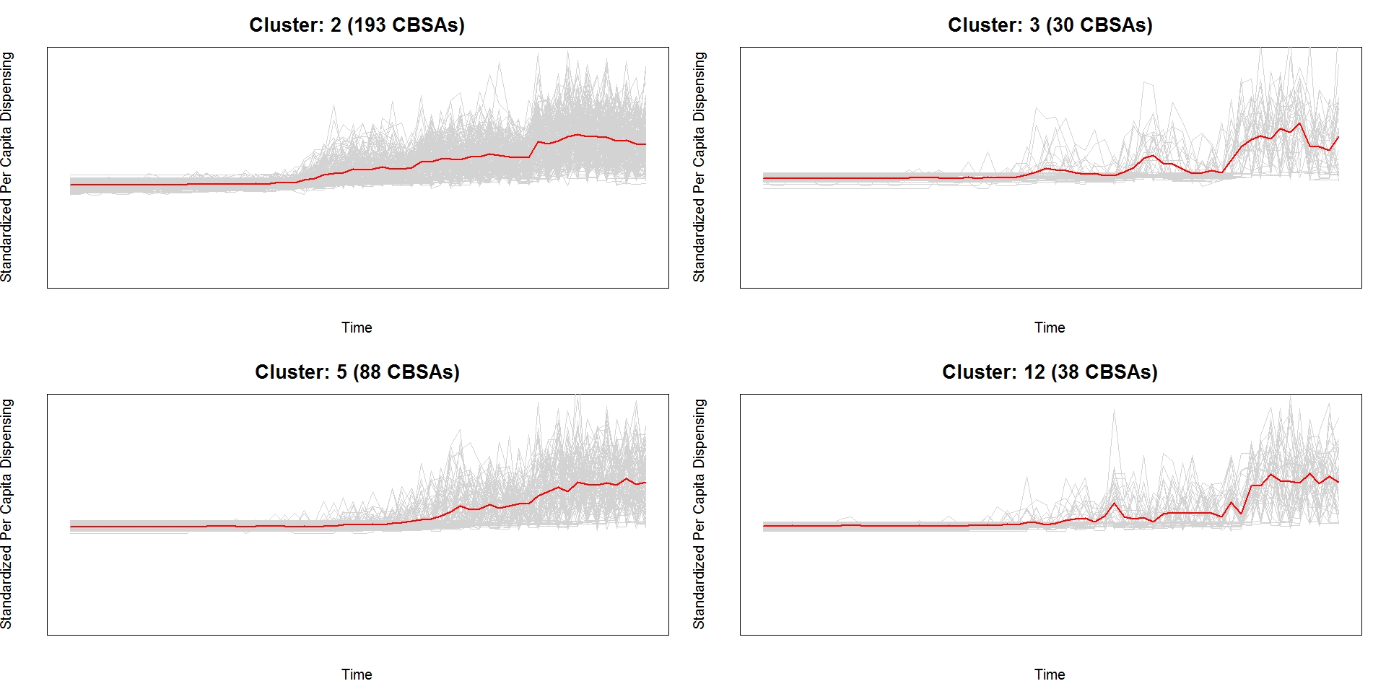
Identifying Geographical Hotspots
Symphony Health PHAST Prescription Monthly. January 2014 - December 2018. Extracted April 2019.

Slide 41
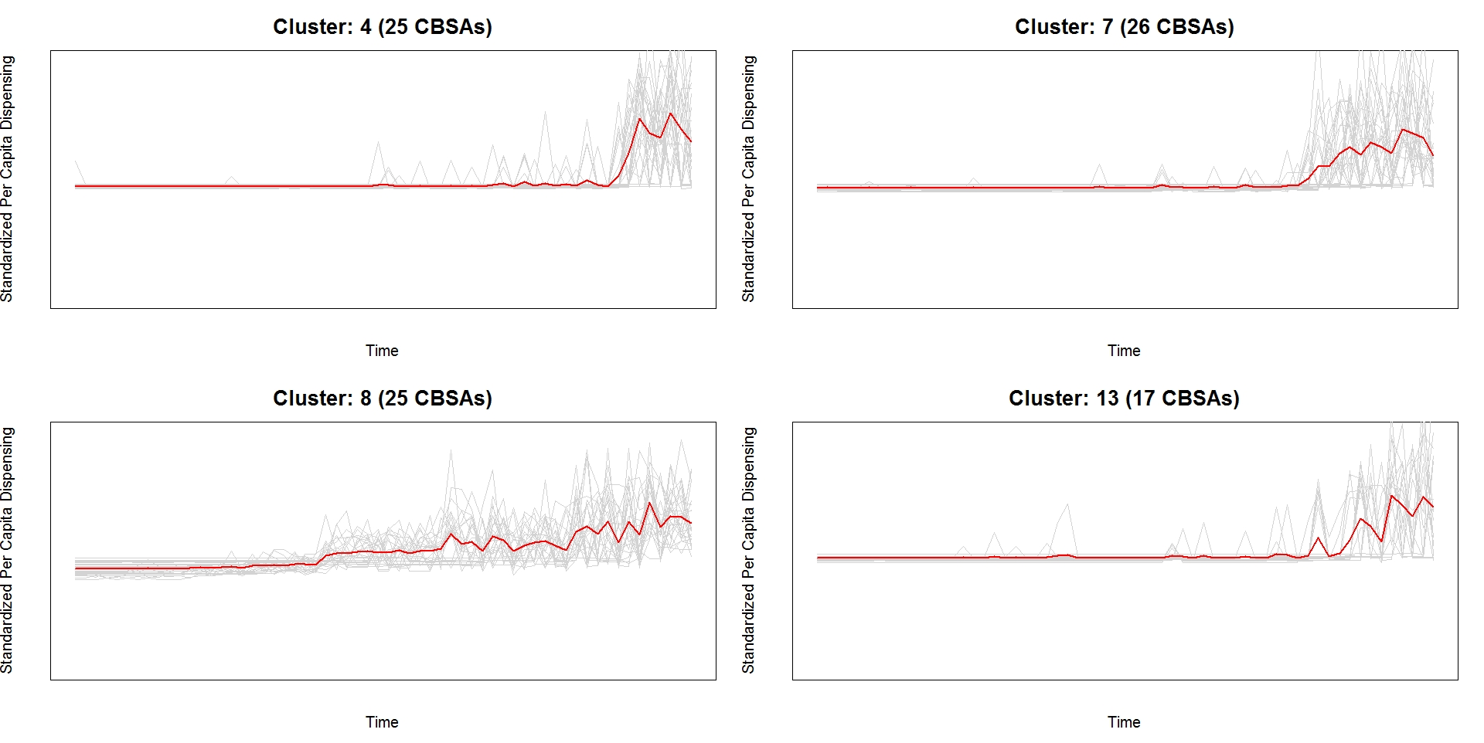
Identifying Geographical Hotspots
Symphony Health PHAST Prescription Monthly. January 2014 - December 2018. Extracted April 2019.

Slide 42
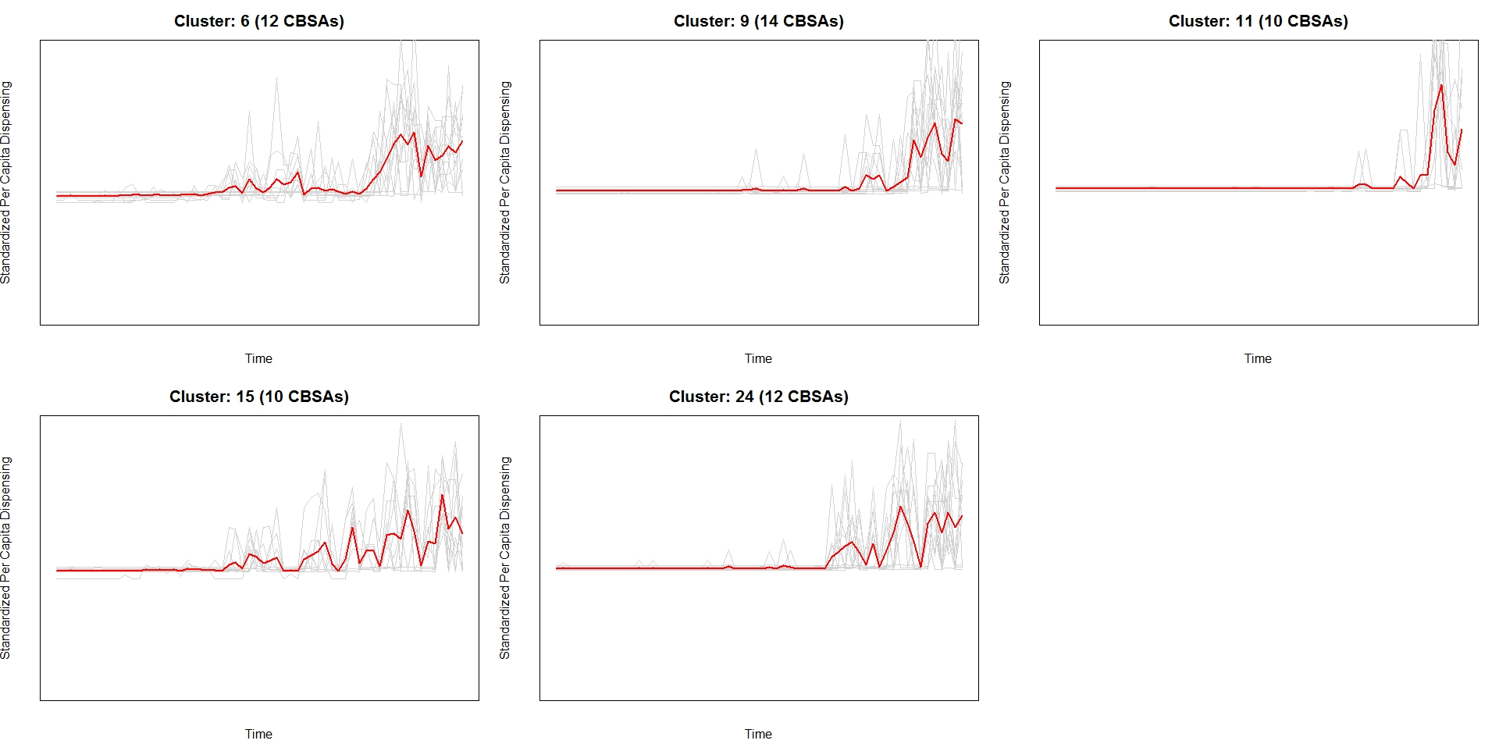
Identifying Geographical Hotspots
Symphony Health PHAST Prescription Monthly. January 2014 - December 2018. Extracted April 2019.

Slide 43
Summary
The two-step procedure can quickly identify small geographic areas that had notable changes in the per capita drug dispensing over time.
The clusters illustrate common trajectories of change among geographic areas.
Ensemble tree-based algorithms can further explore important factors that contributed for the trajectory over time using the enriched data.

Slide 44
Conclusions
Nationally projected data for prescription drug dispensing can be augmented with other geographically referenced, publicly available, demographic, socioeconomic, or healthcare service data.
Objective of this research is to develop a software to perform machine learning and statistical analysis of drug utilization data that will be of interest to the Agency to guide proactive surveillance of drug abuse.
Results of this exploratory analysis can inform further investigations, as drug dispensing data do not measure the product’s ultimate use.

Slide 46
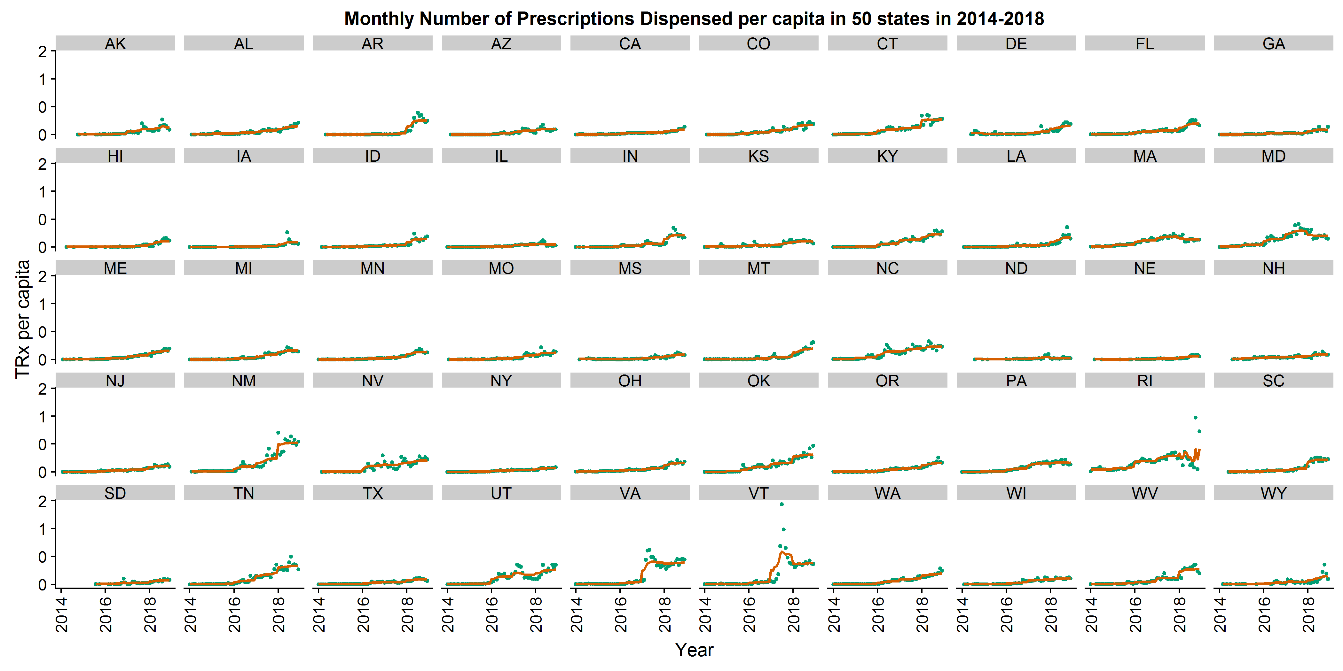
Backup Slide

Slide 47
References
Sohn, M., Talbert, J. C., Huang, Z., et al. (2019). Association of naloxone co-prescription laws with naloxone prescription dispensing in the United States. JAMA Netw Open, 2019;2(6):e196215.
Guy GP Jr., Haegerich TM, Evans ME, Losby JL, Young R, Jones CM. Vital Signs: Pharmacy-Based Naloxone Dispensing — United States, 2012–2018. MMWR Morb Mortal Wkly Rep 2019;68:679–686.
Prescription Drug Abuse Policy System (PDAPS). Naloxone overdose prevention laws. http://pdaps.org/datasets/laws-regulating-administration-of-naloxone-1501695139. Published July, 2017. Accessed September 18, 2019.

Slide 48
References
Wu, S., & Wu, H. (2013). More powerful significant testing for time course gene expression data using functional principal component analysis approaches. BMC Bioinformatics, 14:6.
Carey, M., Wu, S., Gan, G. & Wu, H. (2016). Correlation-based iterative clustering methods for time course data: The identification of temporal gene response modules for influenza infection in humans. Infectious Disease Modeling, 1, 28-39.
Guidance for Industry- Good Pharmacovigilance Practices and Pharmacoepidemiologic Assessment, March 2005: http://www.fda.gov/downloads/RegulatoryInformation/Guidances/UCM126834.pdf

